Slide 1
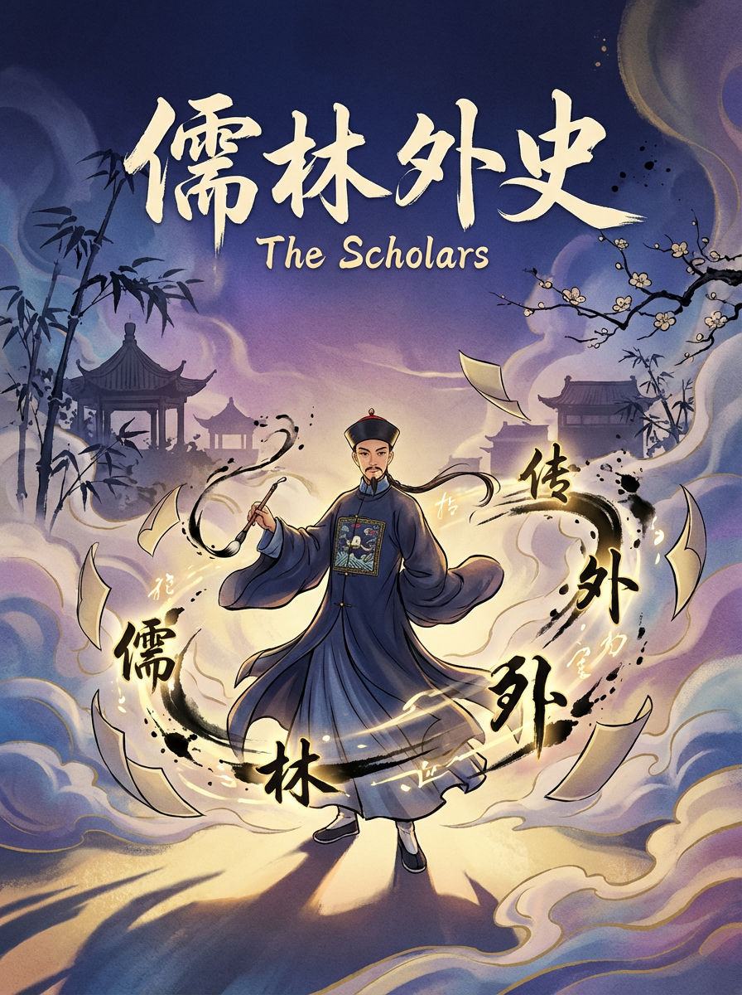
DIGITAL HUMANISTIC ANALYSIS AND REFLECTION
From Political
Center to Cultural Sanctuary
LIN YANG 25124747G
CHC5904

Slide 2

RESEARCH DIRECTION
RESEARCH QUESTIONS
1.Spatial Hierarchy: Does the narrative revolve around the political capital (Beijing) or the cultural centers (Jiangnan)?
2.Urban Functions: How do cities like Nanjing and Yangzhou play different roles in the characters' lives compared to Beijing?
01

Slide 3
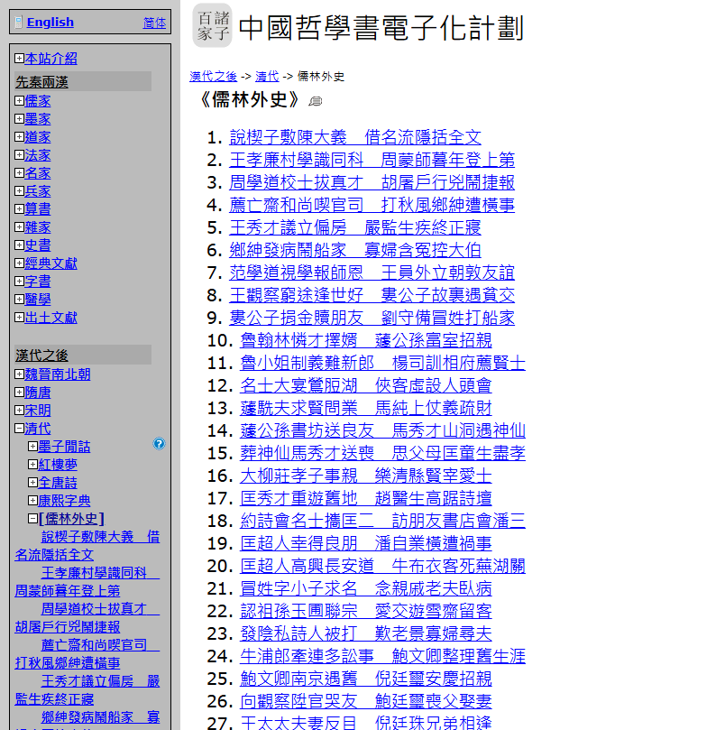
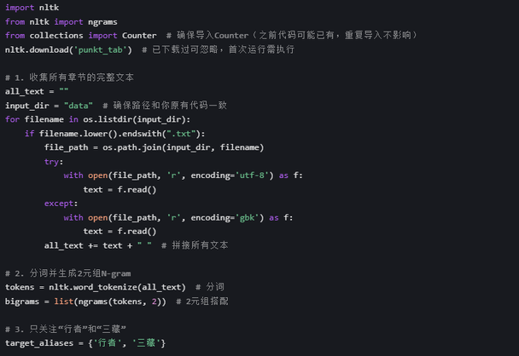
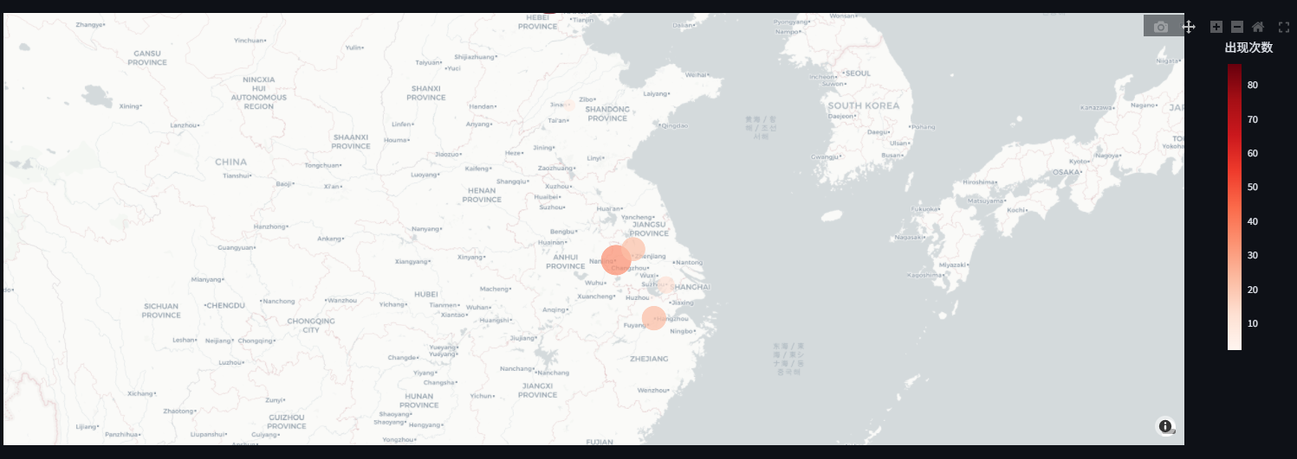
METHODOLOGY & TOOLS
CTEXT.ORG
PYTHON
STREAMLIT
1
→
2
→
3
WORKFLOW
02
Raw Text →Alias Mapping →Frequency Count → GIS Visualization → Close Reading

Slide 4
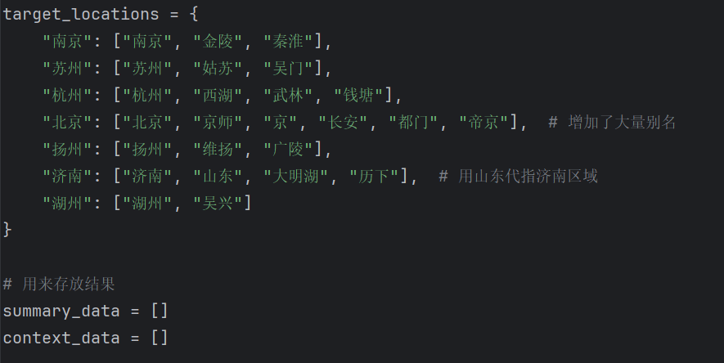
03
Data Processing Challenge
Problem:
Initial algorithms returned "Zero" frequency for Beijing and Jinan.
Discovery:
Close reading revealed historical aliases (e.g., Beijing = "Jingshi/Capital", Jinan = "Shandong").
Solution:
Implemented an Alias Mapping Algorithm in Python to accurately capture hidden data.

Slide 5
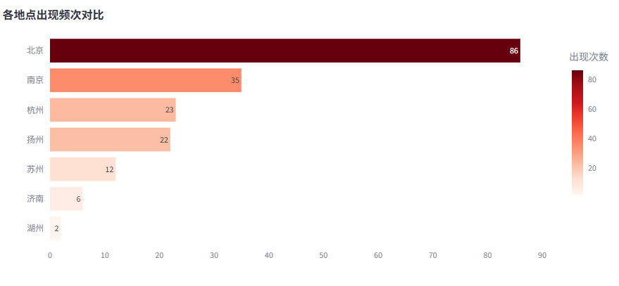
Observation:
The frequency chart shows a decisive dominance of Southern cities.
Data Point:
Nanjing and Yangzhou appear significantly more often than Beijing.
Interpretation:
The novel moves away from the center of political power (North) to the centers of culture and commerce (South).
04
Quantitative Findings

Slide 6
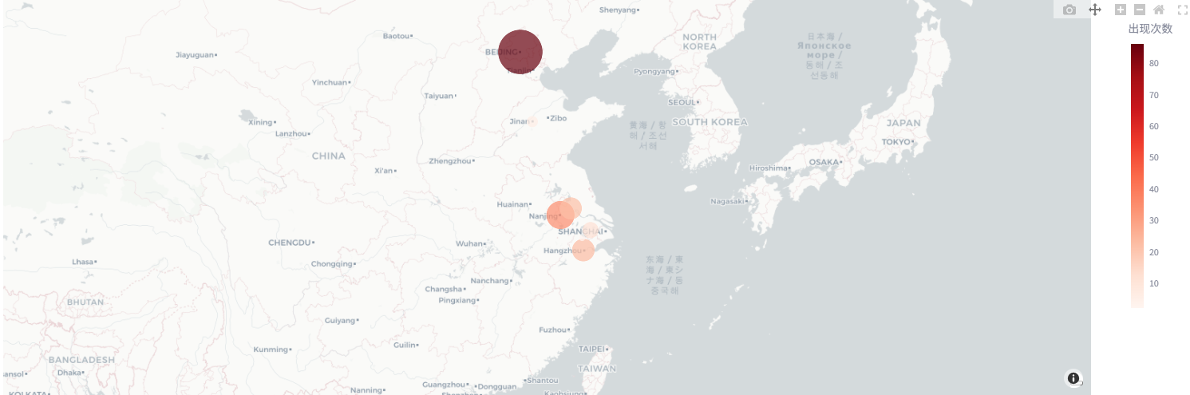
GIS VISUALIZATION ANALYSIS
05
GIS Visualization (Spatial Analysis)
Visualization: An interactive heatmap generated by Plotly/Streamlit.
Analysis: The map visualizes the character's mobility. The "Hot Zone" is clearly concentrated in the Yangtze River Delta (Jiangnan), reflecting the vibrant scholar culture in this region.

Slide 7
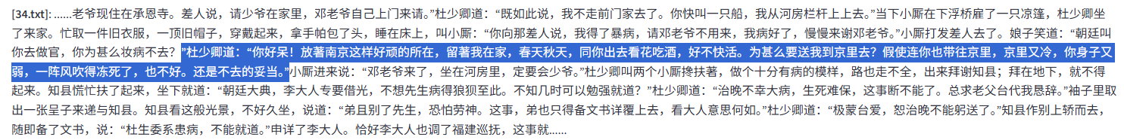
06
Case Study 1 Nanjing
Theme:
The City of "Ritual and Music" (礼乐).
Evidence:
Textual analysis reveals activities such as the "Grand Assembly at Mochou Lake" (莫愁湖大会).
Insight:
Nanjing serves as the spiritual home for scholars, representing high culture and intellectual freedom away from officialdom.
(The Cultural Ideal)

Slide 8
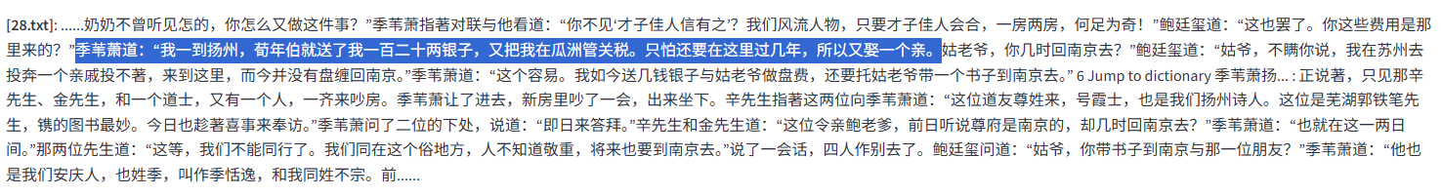
07
Case Study 2 Yangzhou
Theme:
The City of "Commerce and Pragmatism".
Evidence:
Context extraction highlights salt merchants, matrilocal marriages (入赘), and social networking.
Insight:
Yangzhou represents the intersection of literary skill and commercial money. It is more secular and grounded compared to Nanjing.
(The Secular World)

Slide 9
CONCLUSION
08
Revisiting Research Questions:
Beijing is the "Mental Center" (Most mentioned, feared, respected).
Jiangnan is the "Physical Center" (Where life actually happens).
Reflection on Tools:
GenAI & Python: Essential for solving the "Alias Problem" (Beijing vs. Jingshi). Without this, the analysis would have been factually wrong.
Streamlit Map: Provided a "Distant Reading" view that highlights the geographic span of the scholars' network.
Final Thought:
Digital tools help us see the structure (Frequency/Map), while Close Reading helps us understand the sentiment (Why they prefer Nanjing over Beijing).

Slide 10
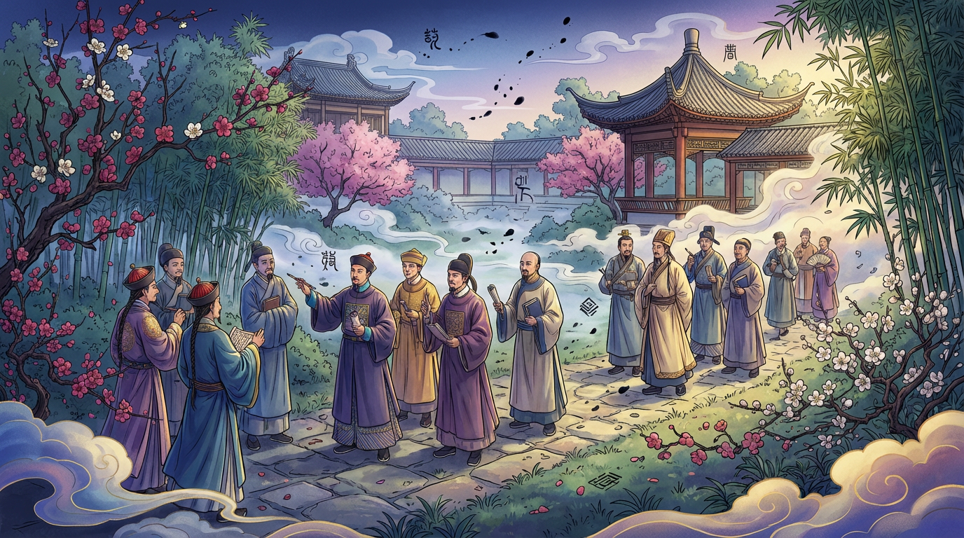
THANK YOU FOR LESTENING!

